Slide 1

Most popular music genres per Billboard Hot 100
Our team project focused on tracking music data trends from the Billboard Hot 100 songs (singles) list from 2000 to 2017.
For our analysis, we considered the following questions:
How is “popularity” of a song determined by Billboard Hot 100?
What genres were the most popular in the Hot 100 list over the years and how is has changed over the years?
Which were the top 5 artist/tracks in the lists?
How does the danceability and other music attributes change over time?
Would other tracking lists (i.e. Rapid, Last FM) would support the Billboard trends?

Slide 2
Billboard Hot 100
The Billboard Hot 100 is the music industry standard record chart in the United States for songs, published weekly by Billboard magazine.
Chart rankings are based on physical and digital sales, radio play, and online streaming in US.
Tracking week for sales and streaming begins on Friday and ends on Thursday, while radio play tracking-week runs from Monday to Sunday. New charts are compiled and officially released to the public on Tuesdays.
The main purpose of the Hot 100 is to reflect the popularity of the singles, albums, etc., and to track the trends of the buying public.

Slide 3
Other sources used
Rapid API: 30,000 radio stations and music charts
Streams daily updated urls, classified by music genre and countries (over 130 countries and 167 music genres)
Last.fm
Builds a detailed profile of user’s musical taste by recording details of the tracks listened from internet radio stations, users’ computers, or portable music devices. Information is transferred to Last.fm’s database either via the music player itself (Spotify, Deezer, Tidal, etc.) or via a plug-in installed into users’ music player.

Slide 4
Billboard Hot 100 data mining and analysis
Using the Billboard Hot 100 URL and API key, a dataset was extracted to begin the analysis. The information was cleaned and formatted and saved on a csv file.
Using pandas and jupyter notebook, we grabbed different elements of the dataset to analyze the information in Data Frames and plots.
The same process was followed for additional API’s used to have a separate dataset and make a similar analysis to verify if the trends were similar to what our analysis on Billboard Hot 100 is showing.

Slide 5
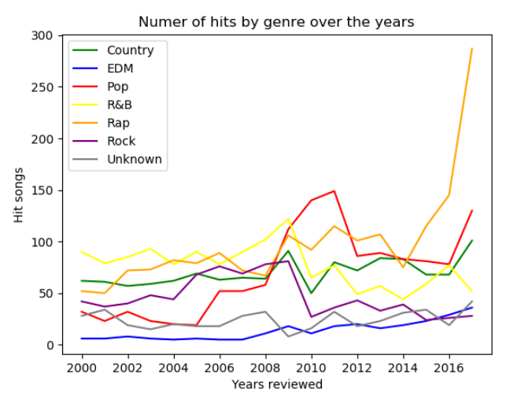
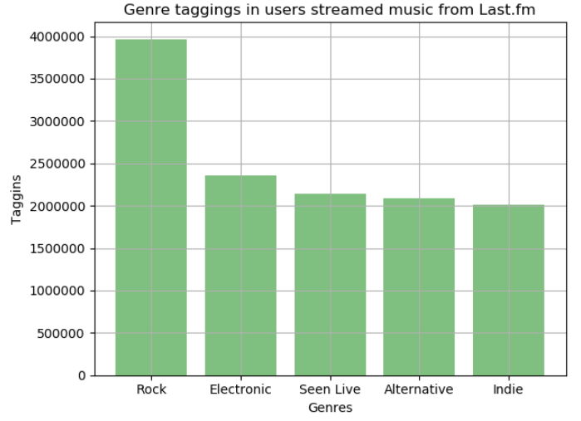
Popular Genre changes over the years (2000-2017)
In the plots below, “Number of hits by genre” refers to the number of times a song tagged with a particular genre was part of the Billboard Hot 100. The count was used to look at the trend of the most tagged genres per Billboard.
Tracks without a clear genre definition, were tagged in the Billboard list as “Unknown”
Rap songs significantly increased on popularity starting 2014.
Pop music had a spike in 2010, its popularity decreased by 2012 and slightly went back up towards 2017.
Popularity of Country music has somehow remained stable over the years analyzed, with some small spikes on 2009 and 2014, in 2017 it was higher than most genres, below Rap and Pop.
EDM popularity has remained constant over the years.
Last.fm data is showing only the current year’s most popular songs (as of August 2019) according to it, Rock is by far the most popular genre streamed, followed by electronic. However, streams from users in other countries are included in this information. We did not have an easy way to extract comparable information to Billboard.

Slide 6
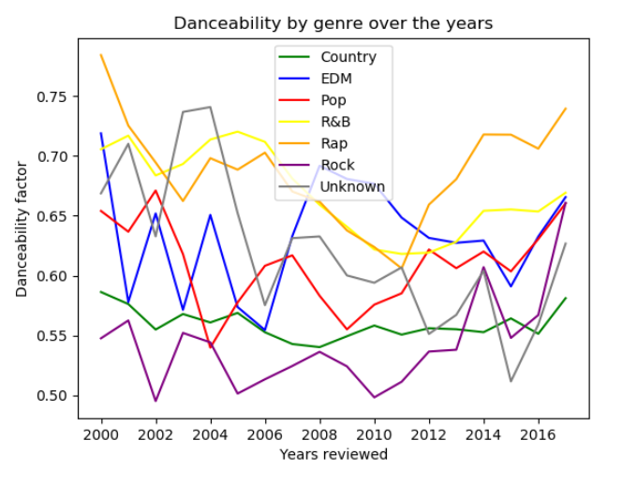
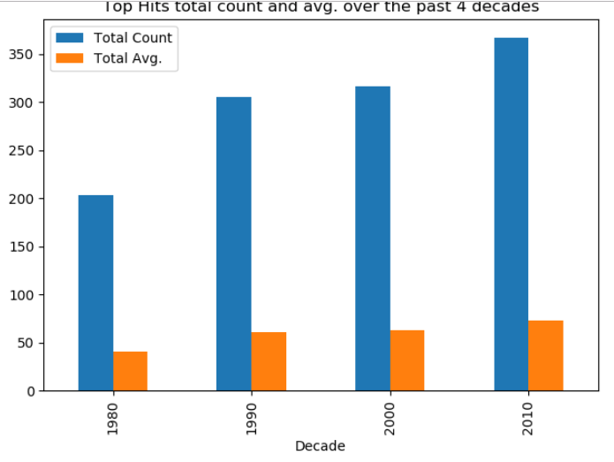
Danceability by genre between 2000-2017
According to Spotify, “Danceability” refers to how suitable a track is for dancing, based on a combination of music elements including tempo, rhythm stability, beat strength, and overall regularity. The value 0.0 is the least danceable and 1.0 is the most danceable.

Slide 7
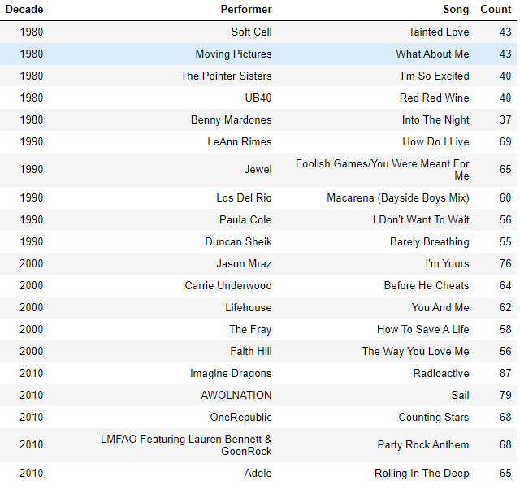
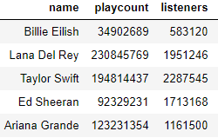
Billboard Hot 100 vs Last.fm – Top Artists

Slide 8
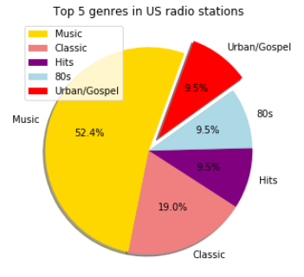
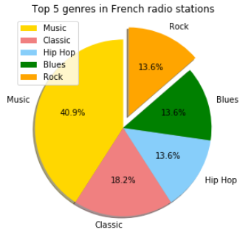
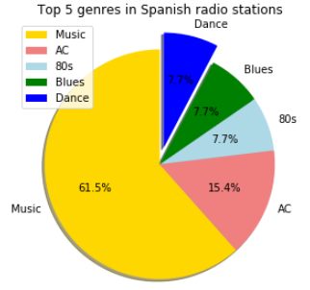
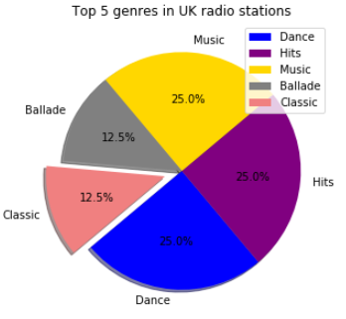
The challenge with the information pulled from the Rapid API was that Radio stations playing hits did not favor any genres, that is where the “Music” label comes from. The plots below show the top 5 genre by radio station in 4 different countries.

